Slide 1
The Physical Layer
Chapter 2

Slide 2
Twisted Pair
Category 3 UTP. Category 5 UTP.
It is the oldest and still most common transmission medium.
A pair consists of two insulated copper wires (about 1 mm thick each). Its most common application is the telephone system.
Twisted pairs can run several km without amplification, but for longer distances, repeaters are needed.
It can transmit either analog or digital information.
The bandwidth depends on the thickness of the wire and the distance traveled. A few Mbps can be achieved for a few km.
Main advantages: adequate performance and low cost.

Slide 3
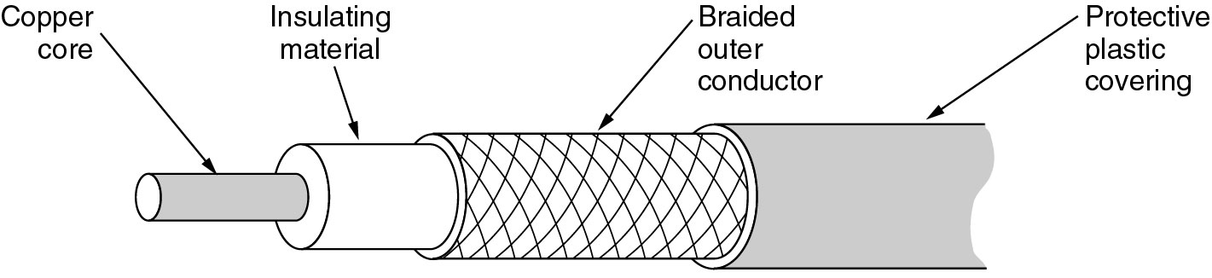
Coaxial Cable
This kind of coaxial cable (50-ohm) is used for digital transmission.
The bandwidth depends on the cable length. For 1-km cables, a data rate of 1 to 2 Gbps is feasible.
It is widely used for LANs and cable TV.

Slide 4
Fiber Optics
In 1981, the IBM PC run at a clock speed of 4.77 MHz. Twenty years later, PCs could run at 2 GHz, a gain of a factor of 20 per decade.
In the same period, data communication went from 56 kbps (ARPANET) to 1 Gbps (modern optical communication), a gain of more than a factor of 125 per decade !
Furthermore, single CPUs are beginning to approach physical limits, such as speed of light and heat dissipation problems. In contrast, with current fiber technology, the achievable bandwidth is above 50,000 Gbps (50 Tbps)!
In the race between computing and communication, communication won.
The new conventional wisdom should be that all computers are hopelessly slow and networks should try to avoid computation at all costs, no matter how much bandwidth that wastes!

Slide 5
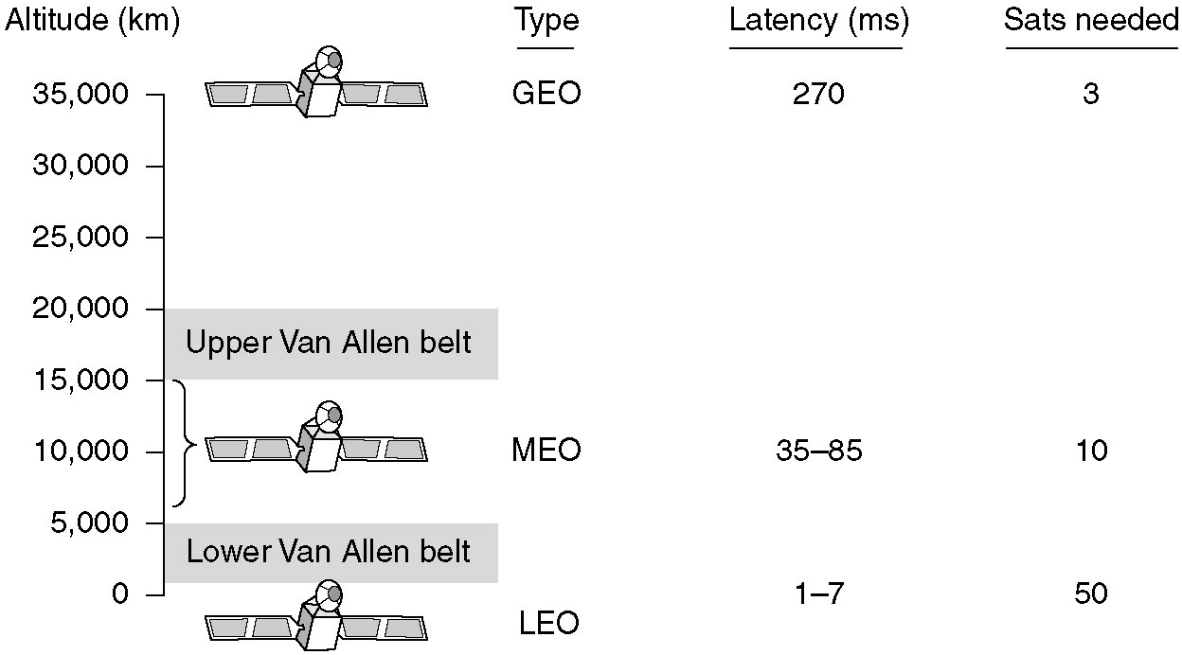
Communication Satellites
Communication satellites and some of their properties, including altitude above the earth, round-trip delay time and number of satellites needed for global coverage.

Slide 6
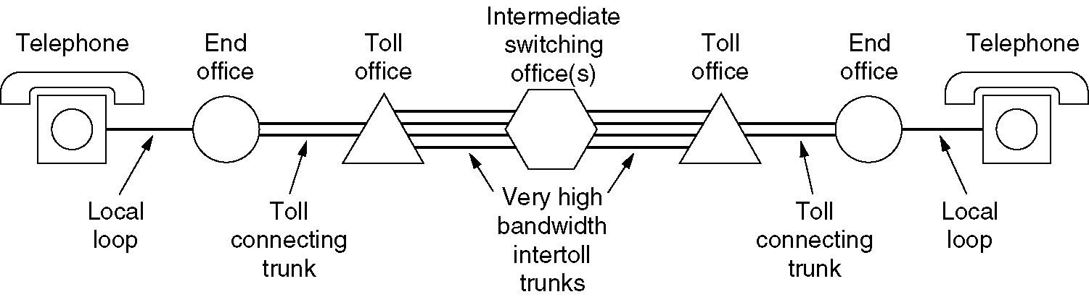
Public Switched Telephone System
A typical circuit route for a medium-distance call
  Each phone has two copper wires going directly to the nearest end office. This connection is called a local loop. The typical distance is 1 to 10 km.
  Each end office has a number of outgoing lines (coaxial cables, microwaves, or even fiber optics) to one or more nearby switching centers, called toll offices.
  Toll offices are connected to sectional or regional offices that form a network, communicating by high bandwidth intertoll trunks (fiber optics).
Local loops use analog signaling, but most intertoll trunks are rapidly being converted to digital transmission

Slide 7
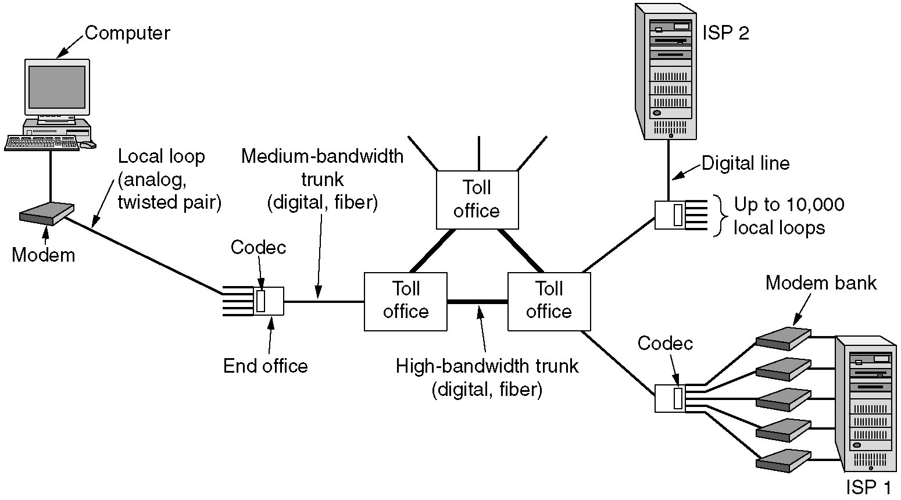
The Local Loop: Modems
The use of both analog and digital transmissions for a computer to computer call. Conversion is done by the modems and codecs.

Slide 8

Trunks and multiplexing
Physical channels are very valuable, so it is worthwhile to multiplex many logical channels over a single physical channel.
Two categories of multiplexing schemes:
  FDM (Frequency Division Multiplexing): the frequency spectrum is divided among the logical channels, with each user having exclusive possession of his frequency band. FDM requires analog circuitry.
  TDM (Time Division Multiplexing): the users take turns (in round robin), each one periodically getting the entire bandwidth for a little burst of time. TDM can be handled entirely by digital electronics, so it has become far more widespread and is mostly used in interoffice trunks for digital data.

Slide 9
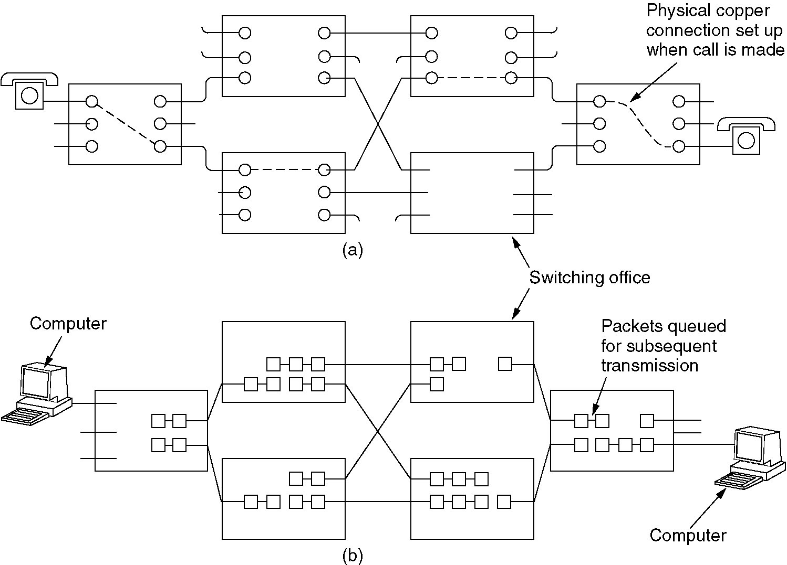
Circuit Switching
Circuit switching:
Packet switching.
In circuit switching, each switching office has a number of incoming lines and outgoing lines.
  When a call passes through a switching office, a physical connection is established between incoming line and an outgoing line.
  Before any data can be sent, an end-to-end path needs to be set up. The setup time can easily be 10 sec or more.
  Once the connection is set up, the only delay for data is the propagation time for electromagnetic signal, about 5 msec per 1000 km, and there is no danger of congestion.

Slide 10
The Mobile Telephone System
CDMA – Code Division Multiple Access
CDMA allows each station to transmit over the entire spectrum and all the time, rather than using FDM and TDM.
CDMA separates multiple simultaneous transmissions using coding theory, which assumes that simultaneous multiple signals add linearly, rather than being garbled.
The key to CDMA is to be able to extract the desired signal while rejecting everything else as random noise.

Slide 11

Comparison of FDM, TDM and CDMA
abc…
abc…
abc…
abc…
FDM
TDM
#$%…
abc…
123…
CDMA

Slide 12


CDMA – Code Division Multiple Access cont.
Each bit time is subdivided into m short intervals called chips. Typically, there are 64 or 128 chips per bit.
Each station is assigned a unique m-bit code called a chip sequence.
To transmit a 1 bit (data), a station sends its chip sequence.
To transmit a 0 bit (data), a station sends the negation (one’s complement) of its chip sequence.
All chip sequences are pair-wise orthogonal, i.e.The normalized inner product of any two distinct chip sequences is 0, S • T = 0.
0 0 1 0 1 1 1 0
-1 -1 +1 -1 +1 +1 +1 -1
+1 +1 -1 -1 +1 -1 +1 -1
----------------------
8
0
*
*
*
*
*
*
*
*
0 0 0 1 1 0 1 1
-1 -1 -1 +1 +1 -1 +1 +1
Binary chip sequences
Bipolar chip sequences
Normalized inner product
  If S • T = 0, then S • ¬T = 0.
  S • S = 1, and S • ¬S = -1.

Slide 13





CDMA: an example
Bit time | A | B | C | D | Received Signals
1 |  |  | 1 |  | S₁=(-1 +1 -1 +1 +1 +1 -1 -1)
2 |  | 1 | 1 |  | S₂=(-2 0 0 0 +2 +2 0 -2)
3 | 1 | 0 |  |  | S₃=( 0 0 -2 +2 0 -2 0 +2)
4 | 1 | 0 | 1 |  | S₄=(-1 +1 -3 +3 +1 -1 -1 +1)
5 | 1 | 1 | 1 | 1 | S₅=(-4 0 -2 0 +2 0 +2 -2)
6 | 1 | 1 | 0 | 1 | S₆=(-2 -2 0 -2 0 -2 +4 0)
A
-1 -1 -1 +1 +1 -1 +1 +1
B
-1 -1 +1 -1 +1 +1 +1 -1
C
-1 +1 -1 +1 +1 +1 -1 -1
D
-1 +1 -1 -1 -1 -1 +1 -1
What did C transmit?
Why it works?
S₁ • C = (1+1+1+1+1+1+1+1)/8 = 1
1
S₆ · C
= (A + B + ¬C + D) · C
= A · C + B · C + ¬C · C + D · C
= 0 + 0 -1 + 0
= -1
S₂ • C = (2+0+0+0+2+2+0+2)/8 = 1
1
S₃ • C = (0+0+2+2+0 -2+0 -2)/8 = 0
-
S₄ • C = (1+1+3+3+1 -1+1 -1)/8 = 1
1
S₅ • C = (4+0+2+0+2+0 -2+2)/8 = 1
1
S₆ • C = (2 -2+0 -2+0 -2 -4+0)/8 = -1
0

